Slide 1




An Introduction to Software development
Women Techsters Bootcamp
In partnership with

Slide 2
What is software development?
The steps of the software development process fit into application life cycle management:
Software development provides a series of steps for programmers to create computer programs. This process makes up the phases in the software development life cycle.
Requirement's analysis and specification
Design and development
Testing
Deployment
Maintenance and support

Slide 3
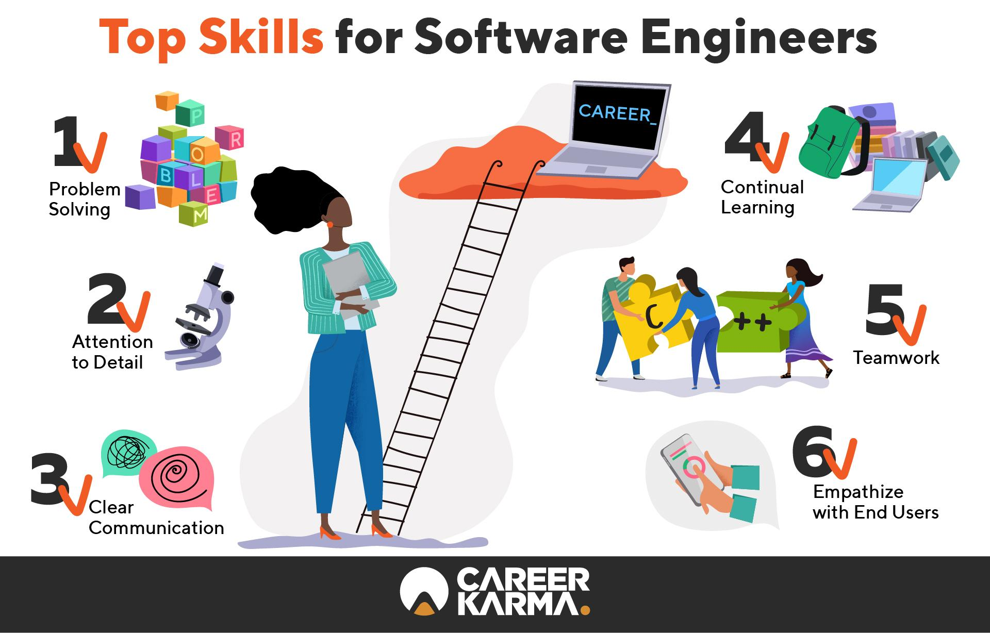

Slide 4
What is frontend development
The frontend of a website is what you see and interact with on your browser. Also referred to as “client-side”, it includes everything the user experiences directly: from text and colors to buttons, images, and navigation menus.
HTML (HyperText Markup Language)
Is the most basic building block of the Web. It defines the meaning and structure of web content. It is used to create and organize web content so it can be displayed by a browser.
Cascading Style Sheets (CSS)
Is a stylesheet language used to describe the presentation of a document written in HTML and other markup languages. It defines the style of a website’s content, such as layout, colors, fonts, etc.
JavaScript
JavaScript is a programming language used for more interactive elements like drop down menus, modal windows, and pop ups.

Slide 5
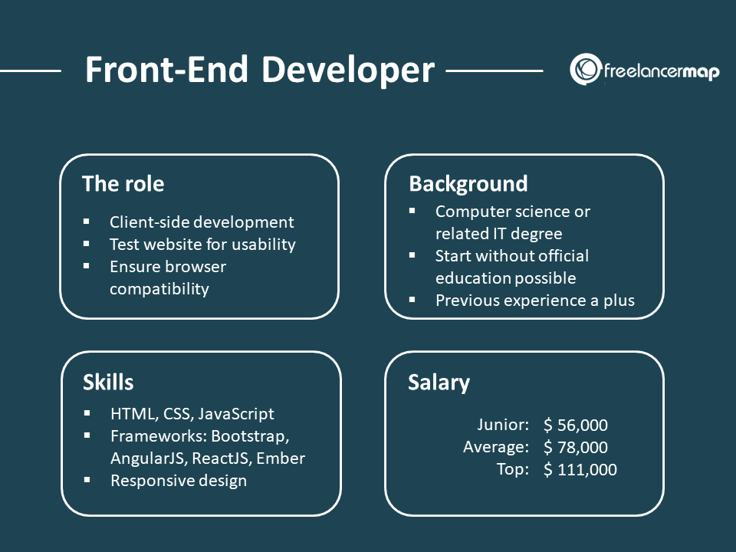

Slide 6
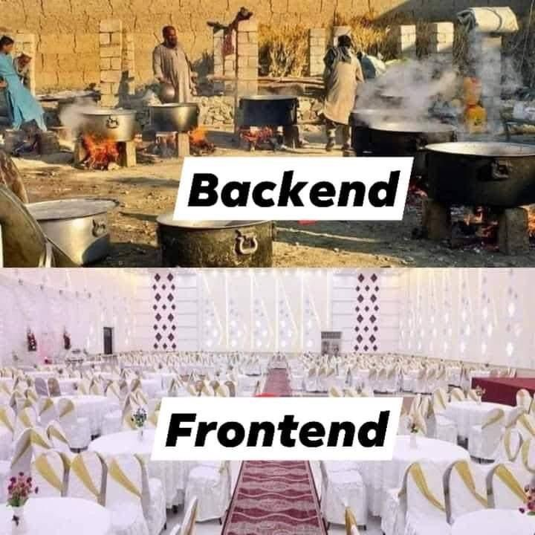

Slide 7
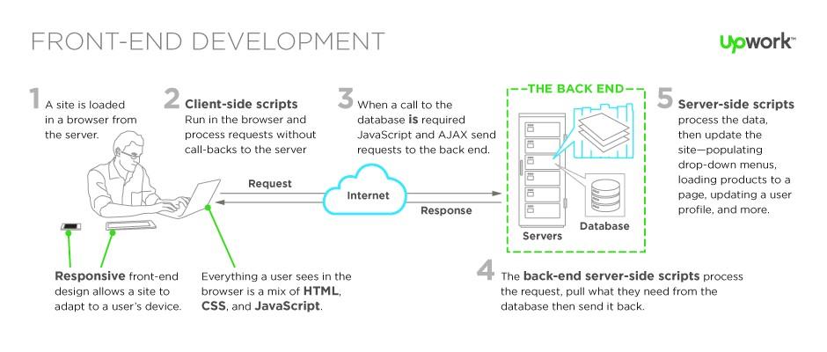
Interaction between frontend and backend

Slide 8
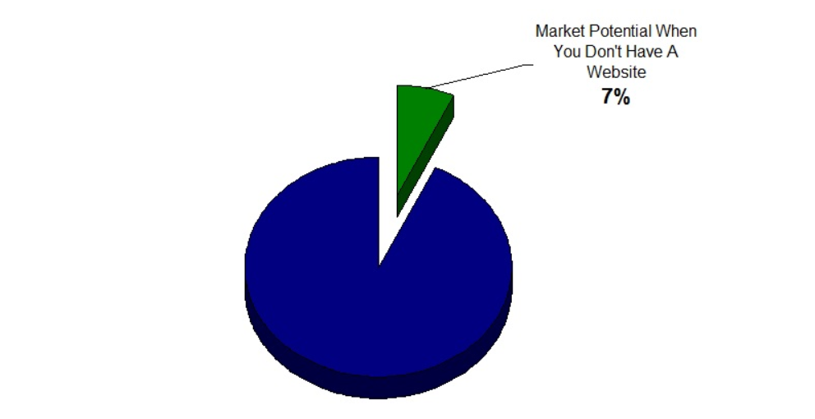
Why software?
93% Of Business Purchase Decisions Start With A Search Engine Search of Websites
Source

Slide 9

Front-End Development Jobs Titles
Front-End Developer
Front-End Engineer
Front-End Web Designer
Front-End Accessibility Expert

Slide 10

Front-End Engineer
a developer who comes from a computer science, engineering background and is using these skills to work with front-end technologies.
This role typically requires a computer science degree and years of software development experience.

Slide 11
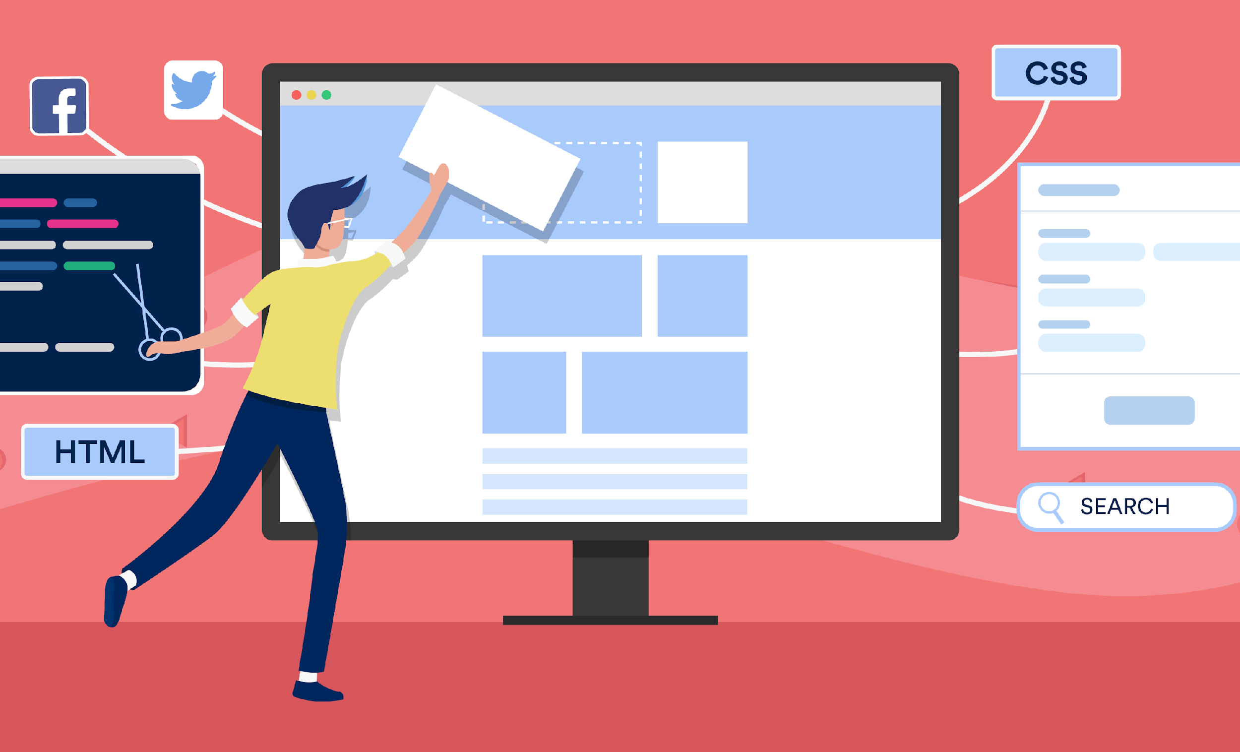
Front-End Designer
When the word "Designer" is included in the job title:
this will denote that the designer will possess front-end skills (i.e., HTML & CSS)
but also professional design (Visual Design and Interaction Design) skills.

Slide 12
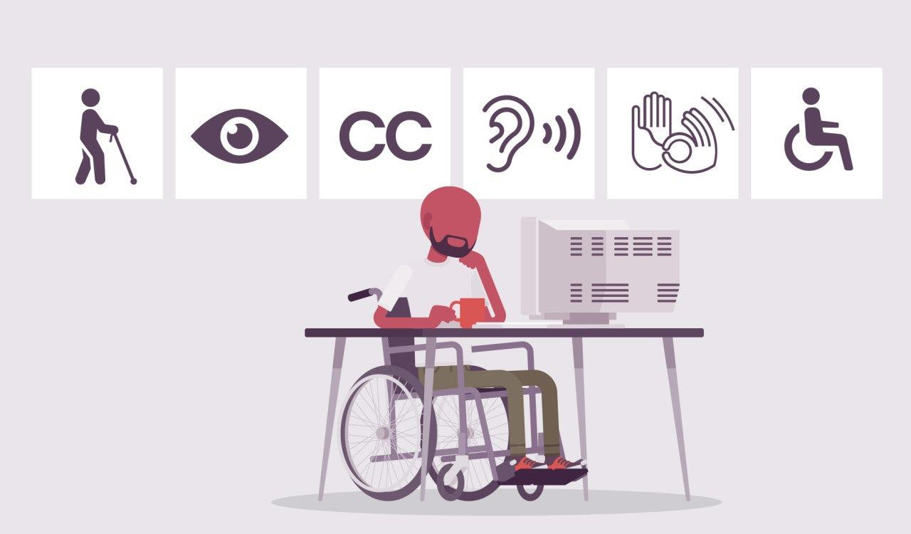
When the word "Accessibility" is included in the front-end job title:
this will denote that the developer has extensive experience crafting front-end technologies that support accessibility requirements and standards.
Front-End Accessibility Expert

Slide 13
Core competencies/skills of a frontend developer
Determining the structure and design of web pages.
Striking a balance between functional and aesthetic design.
Building reusable code for future use
Optimizing web pages for maximum speed and scalability.
Implement responsive design across different devices and web browsers

Slide 14
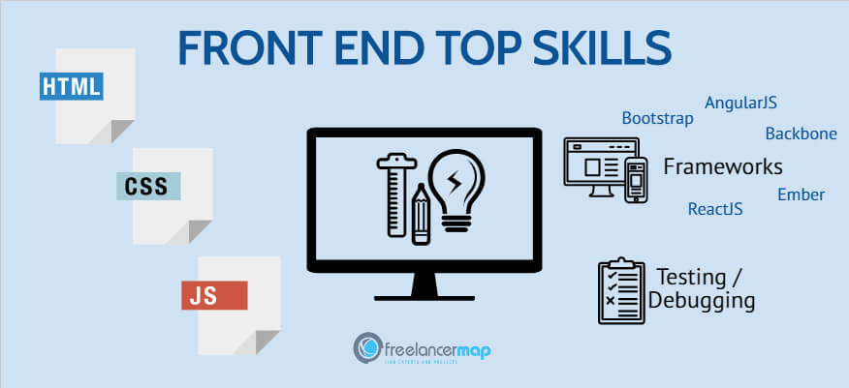

Slide 15
What to Expect in this Course
Understand the fundamentals of HTML and CSS
Know the basic use of JavaScript
Learn to DOM Manipulation using JavaScript
Quiz
Individual Assignments
Group Project

Slide 16
Course Outline
Module 1 : Week 1
Intro. to HTML and CSS
Intro. to JavaScript

Slide 17
Course Outline
Module 2: Week 2
Deep Dive into HTML and CSS
DOM Manipulation and JavaScript

Slide 18


Tools for this course
Code Editor: Visual Studio Code
Browser: Microsoft Edge

Slide 19

Thank You!
Women Techsters Bootcamp
In partnership with

